Slide 1
Travel agent
IBM AICTE PROJECT
Presented By:
Student name : Srinjoy Poddar
College Name & Department : Sikkim Manipal Institute of Technology, B.Tech CSE(AI&ML)

Slide 2
OUTLINE
Problem Statement
Technology used
Wow factor
End users
Result
Conclusion
Git-hub Link
Future scope
IBM Certifications

Slide 3
Problem Statement
Travelers face difficulties in planning trips due to the overwhelming amount of information available, varying preferences, budget constraints, and the need for real-time updates. Manually researching, comparing, and coordinating travel options is time-consuming and prone to errors.
Proposed Solution: An AI-powered Travel Planner Agent that leverages real-time data, user preferences, and machine learning algorithms to create personalized, optimized travel itineraries. The agent will integrate with maps, weather updates, and local guides, ensuring a seamless and enjoyable travel experience.

Slide 4
Technology used
IBM cloud lite services
Natural Language Processing (NLP)
Retrieval Augmented Generation (RAG)
IBM Granite model

Slide 5
IBM cloud services used
IBM Cloud Watsonx AI Studio
IBM Cloud Watsonx AI runtime
IBM Cloud Agent Lab
IBM Granite foundation model

Slide 6
Wow factors
This agent will revolutionize travel planning by providing personalized, real-time recommendations, optimizing schedules, and ensuring a smooth travel experience.
Unique features:
Real-time data integration for destination suggestions and itinerary building
Personalized recommendations based on user preferences, budget, and constraints
Integration with maps, weather updates, and local guides for a seamless experience
Dynamic schedule optimization and booking management
Proactive alerts for changes in travel plans

Slide 7
End users
Individual Travelers
Travel Agencies
Tour Operators
Event Planners
Corporate
Travel Departments

Slide 8
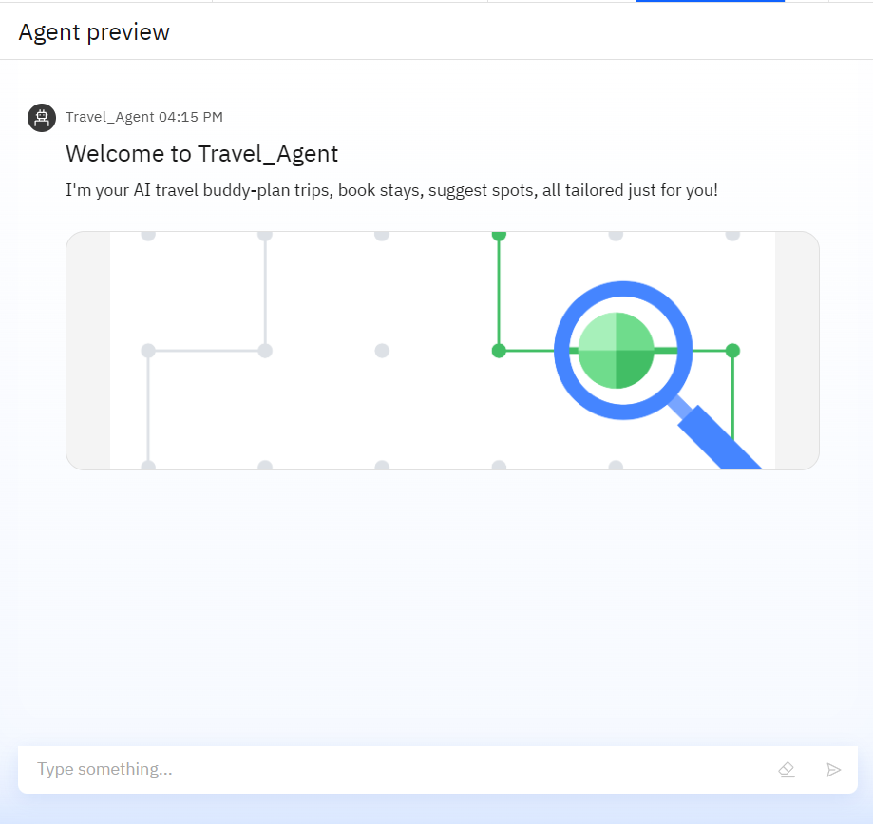
Results

Slide 9
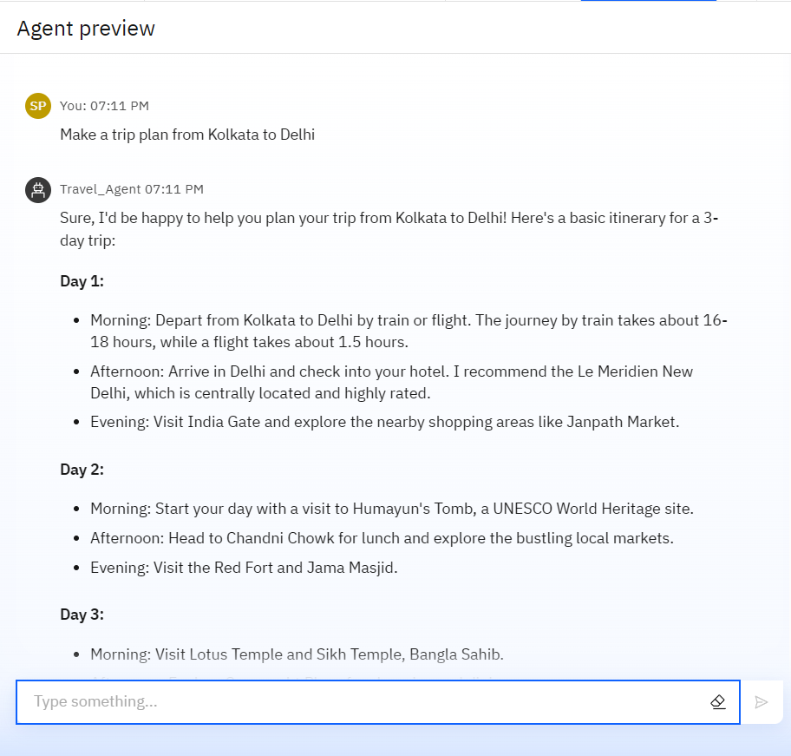
Results

Slide 10
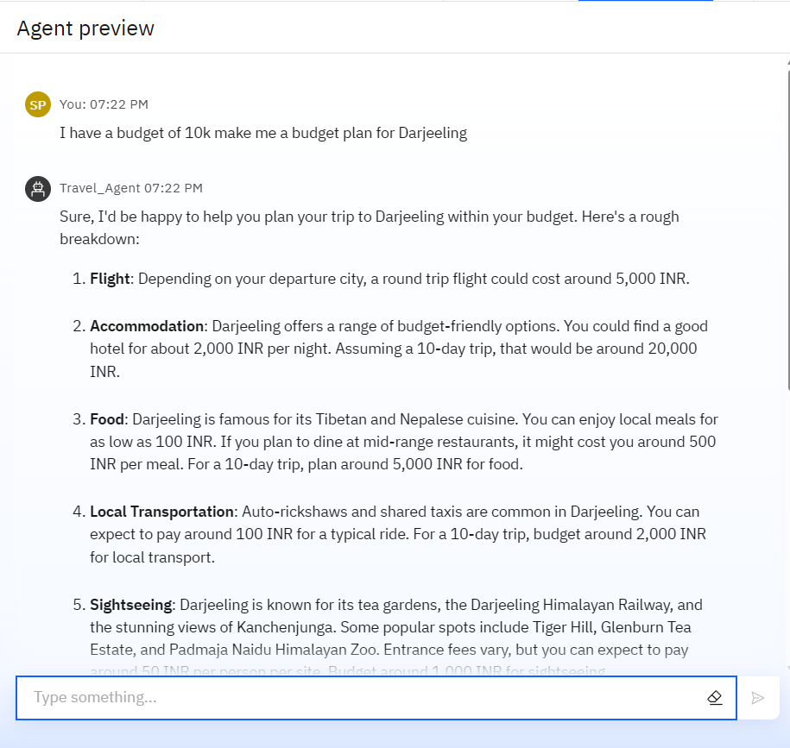
Results

Slide 11
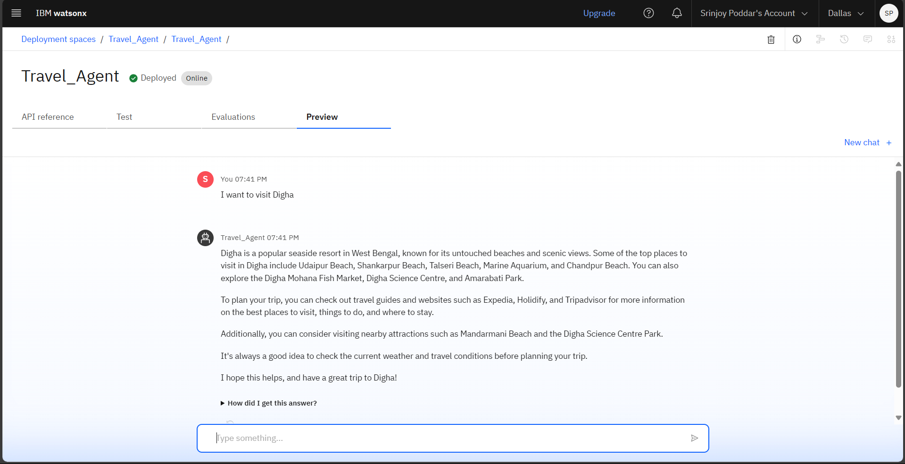
Results
Deployed AI Agent

Slide 12
Conclusion
This smart assistant transforms complex travel planning into a seamless, enjoyable process.
It uses real-time data to suggest destinations, build itineraries, and recommend transport and accommodation options.
By understanding user preferences, budgets, and constraints, it tailors personalized travel plans.
Integrated with maps, weather updates, and local guides, it ensures a smooth travel experience.

Slide 13
GitHub Link
https://github.com/Srinjoy776/Travel_Agent2

Slide 14
Future scope
Virtual Reality Itinerary Planning
AI-Driven Local Recommendations
Real-Time Travel Alerts and Updates
Multi-Modal Transport Integration
Sustainable Travel Options and Carbon Footprint Tracking
AI-Powered Language Translation for International Travel

Slide 15
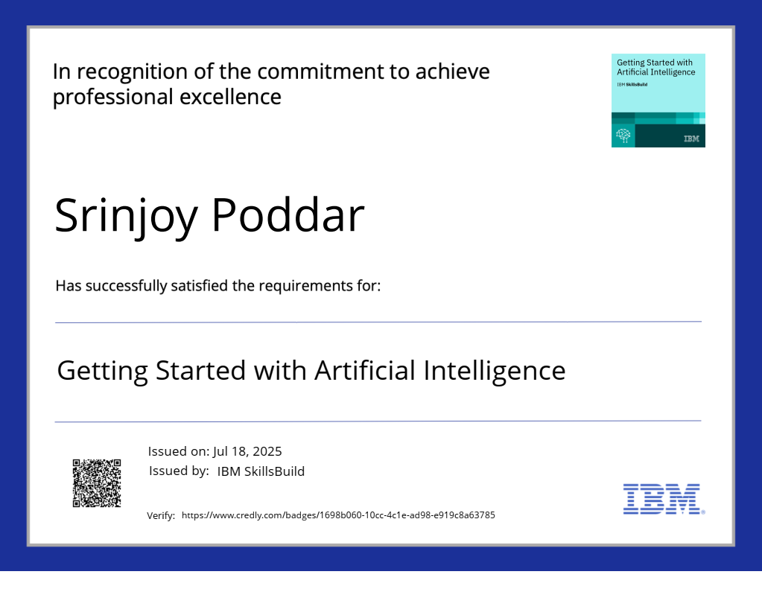
IBM Certifications

Slide 16
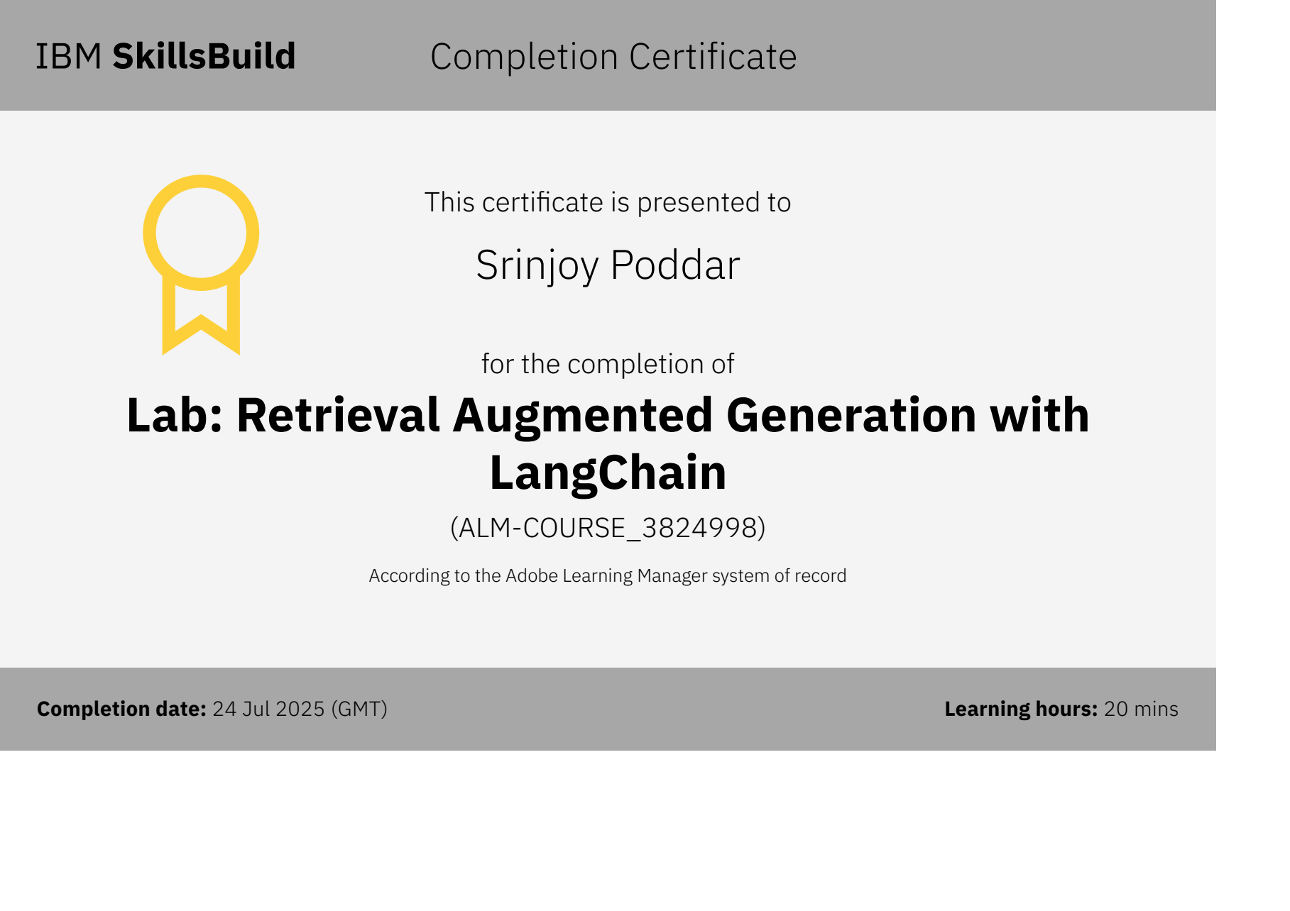

Slide 17
THANK YOU

